Slide 1
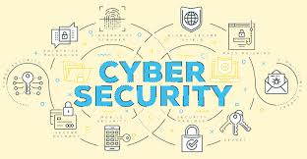
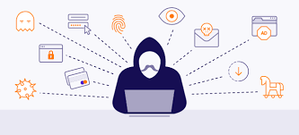
CA 501 : CYBER SECURITY
Chapter 3 : Tools and Methods Used in Cybercrime

Slide 2

Let’s Start
Topics:
3.1 Introduction
3.2 Proxy Servers and Anonymizers
3.3 Phishing
3.4 Password Cracking
3.5 Keyloggers and Spywares
3.6 Virus and Worms
3.7 Trojan Horses and Backdoors
3.8 Steganography
3.9 DoS and DDoS Attacks
3.10 SQL Injection

Slide 3
Proxy Servers and Anonymizers
PROXY SERVER:
- In the world of cyber security, proxy servers are an important tool in protecting your online privacy. Proxy servers act as a middleman between your computer and the websites you visit. This makes it difficult for hackers or cyber criminals to track your activities online.
- A proxy server is a system or router that provides a gateway between users and the internet. Therefore, it helps prevent cyber attackers from entering a private network. It is a server, referred to as an “intermediary” because it goes between end-users and the web pages they visit online.
When a computer connects to the internet, it uses an IP address. This is similar to your home’s street address, telling incoming data where to go and marking outgoing data with a return address for other devices to authenticate. A proxy server is essentially a computer on the internet that has an IP address of its own.

Slide 4
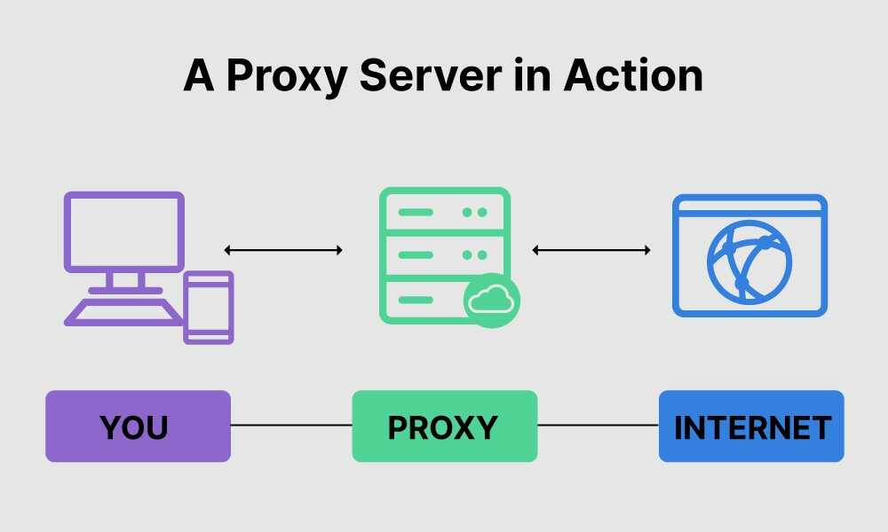
Proxy Servers and Anonymizers
PROXY SERVER:

Slide 5
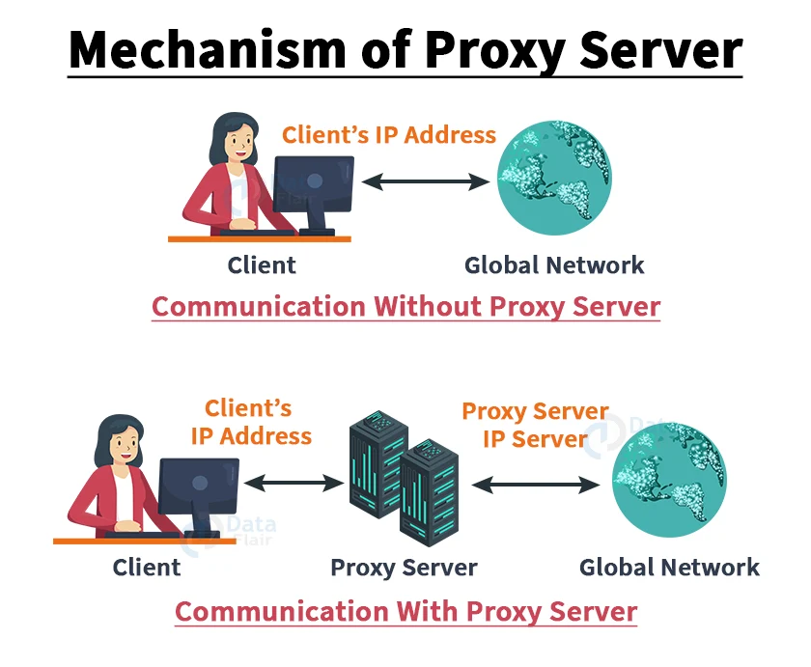
Proxy Servers and Anonymizers

Slide 6
Proxy Servers and Anonymizers
PROXY SERVER:
- A proxy server is a dedicated computer or a software system running on a computer that acts as an intermediary between an endpoint device, such as a computer, and another server from which a user or client is requesting a service.
- A client connects to the proxy server, requesting some service, such as a file, connection, web page, or other resource available from a different server and the proxy server evaluates the request as a way to simplify and control its complexity.
- Attack on this: the attacker first connects to a proxy server- establishes connection with the target through existing connection with the proxy
- Proxies were invented to add structure and encapsulation to distributed systems. Today, most proxies are web proxies, facilitating access to content on the World Wide Web and providing anonymity.

Slide 7
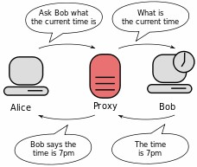
Proxy Servers and Anonymizers
Purpose of a proxy server
➢ Improve Performance:
➢ Filter Requests
➢ Keep system behind the curtain
➢ Used as IP address multiplexer
➢ Its Cache memory can serve all users

Slide 8
Proxy Servers and Anonymizers
Types of proxy –
A proxy server may reside on the user’s local computer, or at various points between the user’s computer and destination servers on the Internet.
1. A proxy server that passes requests and responses unmodified is usually called a gateway or sometimes a tunneling proxy.
2. A forward proxy is an Internet-facing proxy used to retrieve from a wide range of sources (in most cases anywhere on the Internet).
3. A reverse proxy is usually an Internet-facing proxy used as a front-end to control and protect access to a server on a private network. A reverse proxy commonly also performs tasks such as load-balancing, authentication, decryption or caching.

Slide 9
Proxy Servers and Anonymizers
Anonymizer:
- An anonymizer or an anonymous proxy is a tool that attempts to make activity on the Internet anonymous or untraceable.
- It is a proxy server computer that acts as an intermediary and privacy shield between a client computer and the rest of the Internet.
- It accesses the Internet on the user’s behalf, protecting personal information by hiding the client computer’s identifying information.
- There are many reasons for using anonymizers. Anonymizers help minimize risk. They can be used to prevent identity theft, or to protect search histories from public disclosure.
- Some countries apply heavy censorship on the internet. Anonymizers can help in allowing free access to all of the internet content, but cannot help against harassment for accessing the Anonymizer website itself.

Slide 10
Proxy Servers and Anonymizers
- Furthermore, as information itself about Anonymizer websites are banned in these countries, users are suspicious that they may be falling into a government-set trap.
- Anonymizers are also used by people who wish to receive objective information with the growing target marketing on the internet and targeted information.
- For example, large news outlets such as CNN target the viewer’s according to region and give different information to different populations.
- Websites such as YouTube obtain information about the last videos viewed on a computer, and propose “recommended” videos accordingly, and most of the online targeted marketing is done by showing advertisements according to that region.
- Anonymizers are used for avoiding this kind of targeting and getting a more objective view of information.

Slide 11
Proxy Servers and Anonymizers
Types:
1. Protocol specific anonymizers:
- Sometimes anonymizers are implemented to work only with one particular protocol. The advantage is that no extra software is needed.
- The operation occurs in this manner:
- A connection is made by the user to the anonymizer. Commands to the anonymizer are included inside a typical message. The anonymizer then makes a connection to the resource specified by the inbound command and relays the message with the command stripped out.
- An example of a protocol-specific anonymizer is an anonymous remailer for e-mail. Also of note are web proxies and bouncers for FTP and IRC.

Slide 12
Proxy Servers and Anonymizers
2. Protocol independent anonymizers:
- Protocol independence can be achieved by creating a tunnel to an anonymizer.
- The technology to do so varies. Protocols used by anonymizer services may include SOCKS, PPTP, or Open VPN.
- In this case either the desired application must support the tunneling protocol, or a piece of software must be installed to force all connections through the tunnel.
- Web browsers, FTP and IRC clients often support SOCKS for example, unlike telnet.

Slide 13
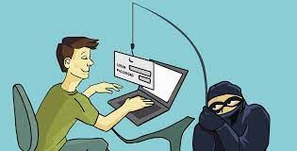
Phishing
- Phishing is a type of social engineering where an
attacker sends a fraudulent ("spoofed") message
designed to trick a human victim into revealing
sensitive information to the attacker or to deploy malicious software on the victim's infrastructure like ransomware.
- Phishing attacks have become increasingly sophisticated and often transparently mirror the site being targeted, allowing the attacker to observe everything while the victim is navigating the site, and transverse any additional security boundaries with the victim.
- Phishing attacks are the practice of sending fraudulent communications that appear to come from a reputable source. It is usually done through email. The goal is to steal sensitive data like credit card and login information, or to install malware on the victim’s machine.
- Phishing is a common type of cyber-attack that everyone should learn about in order to protect themselves.

Slide 14
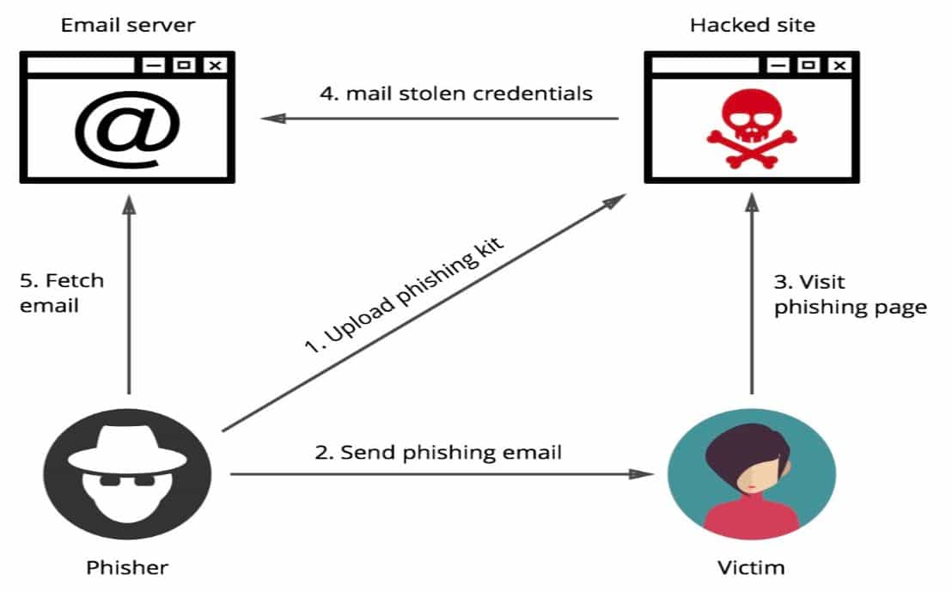
Phishing
- All the resources and tools needed for a phishing website were available in the phishing kit. The hacker can install the phishing kit on a website and start sending emails to prospective victims. The design of the kit is such that it looks like a perfect replica of a legitimate site.
Phishing kits and tools are widely available online, especially on the Dark Web.

Slide 15
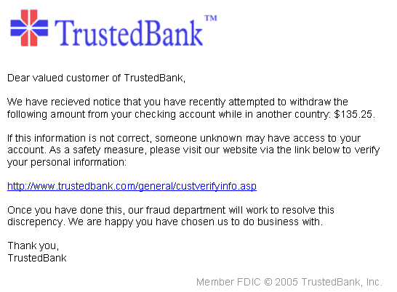
Phishing
- Example:
1. An example of a phishing email, disguised as an official email from a (fictional) bank. The sender is attempting to trick the recipient into revealing confidential information by "confirming" it at the phisher's website. Note the misspelling of the words received and discrepancy as received and discrepancy, respectively.

Slide 16
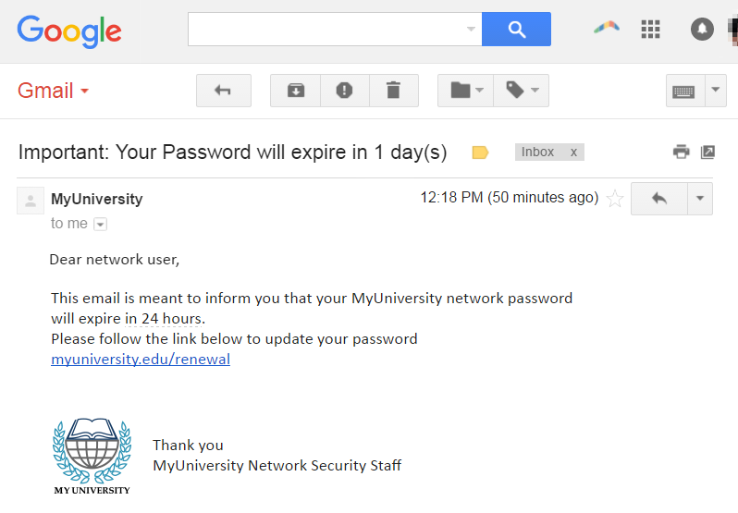
Phishing
- Example:
2. A spoofed email ostensibly from myuniversity.edu is mass-distributed to as many faculty members as possible.
The email claims that the user’s password is about to expire. Instructions are given to go to myuniversity.edu/renewal to renew their password within 24 hours.

Slide 17
Phishing
- Attempt to steal credentials for Microsoft accounts:
In August 2020, attackers sent phishing emails attempting to steal Microsoft account credentials. The messages attempted to trick the victim into clicking a malicious link that redirected to a fake Microsoft login page.
- Amazon phishing email attempts to steal credit card information:
In September 2020, attackers sent a phishing email, which appeared to be from Amazon, attempting to steal user credit card information. The email claimed that the user’s account was deactivated due to too many login failures, and linked to a fake Amazon Billing Center website, which instructed the user to re-enter their payment information.

Slide 18
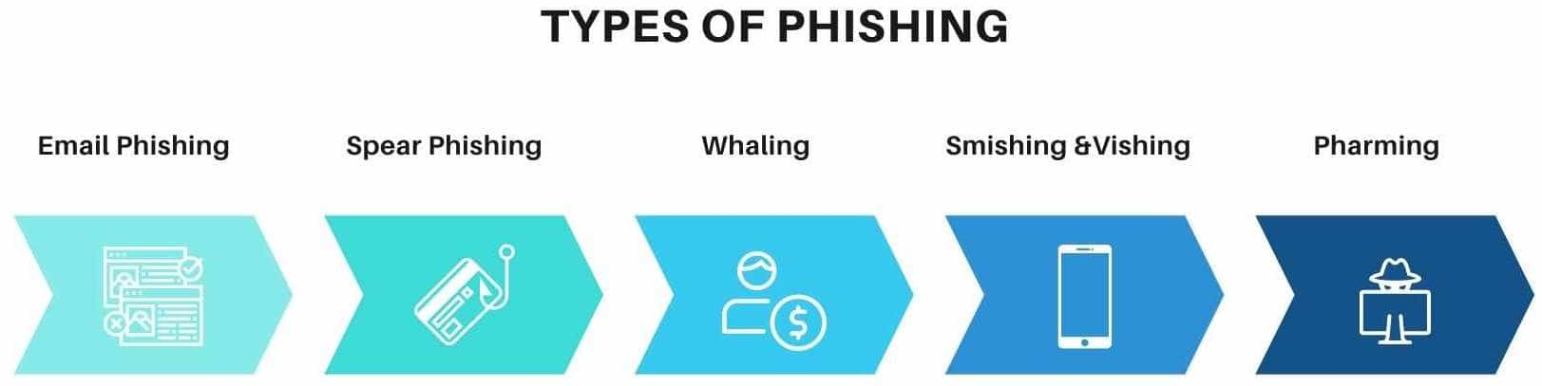
Phishing
1. Email phishing:
The majority of phishing attacks are made by sending emails. A fake domain, which is a mirror of the genuine one, is created by fraudsters and sent to thousands of people at a time. They may request things like:
Login credentials
Passwords
Bank account numbers
Since they impersonate familiar individuals or organizations, users instantly turn into victims.

Slide 19
Phishing
- These fake domains usually have a minor difference in spelling, like the letters “r” and “n” can be used together as “rn” to look like an “m.”
The best way to spot phishing emails is to stay alert and keep a look out for warning signals by re-checking the email address before clicking on these links or downloading attachments.
2. Spear phishing:
Spear phishing is an attack made to a specific person or a specific organization via email. Fraudsters keep track of the victim and have all of their personal details like: Address, Phone number, Hometown, Friends, Email address, Job designation, And many more
Research indicates that nearly 90% of companies have faced spear phishing attacks.

Slide 20
Phishing
3. Whaling:
Whaling attacks are targeted at senior executives (CEOs, MDs, CTOs, or any other individuals having top-notch designations). These high-profile individuals tend to use personal email ids for business interactions, which may lack corporate web protections.
Though whaling attacks tend to take time, they promise high payoffs. Since attackers use actual corporate logos and spoofed email addresses for making communication look genuine, and show that they are from trustworthy sources, duping becomes simpler.
For example, one of the most notable corporate cyber-crimes involved an employee of The Scoular Co. who was duped of $17.2 million by whaling.

Slide 21
Phishing
4. Smishing & vishing:
In both these phishing attacks, emails are replaced by mobile phones for communicating with victims. Here the user is lured into downloading a virus or trojan horse into their mobile device. Vishing is carried out by using voice technology.
5. Pharming:
Pharming is done by injecting malicious codes into the system. It redirects system traffic to fake sites created by hackers. This can be done without the victim's awareness.

Slide 22
Password Cracking
- Password cracking is the process of recovering passwords from data that has been stored in or transmitted by a computer system in scrambled form. A common approach (brute-force attack) is to repeatedly try guesses for the password and to check them against an available cryptographic hash of the password.
Another type of approach is password spraying, which is often automated and occurs slowly over time in order to remain undetected, using a list of common passwords.
Password cracking is the process of using an application program to identify an unknown or forgotten password to a computer or network resource. It can also be used to help a threat actor obtain unauthorized access to resources.
With the information malicious actor gain using password cracking, they can undertake a range of criminal activities. Those include stealing banking credentials or using the information for identity theft and fraud.

Slide 23
Password Cracking
- A password cracker recovers passwords using various techniques. The process can involve comparing a list of words to guess passwords or the use of an algorithm to repeatedly guess the password.
The purpose of password cracking might be to help a user recover a forgotten password (installing an entirely new password is less of a security risk, but it involves System Administration privileges), to gain unauthorized access to a system, or to act as a preventive measure whereby system administrators check for easily crackable passwords.
On a file-by-file basis, password cracking is utilized to gain access to digital evidence to which a judge has allowed access, when a particular file's permissions are restricted.

Slide 24
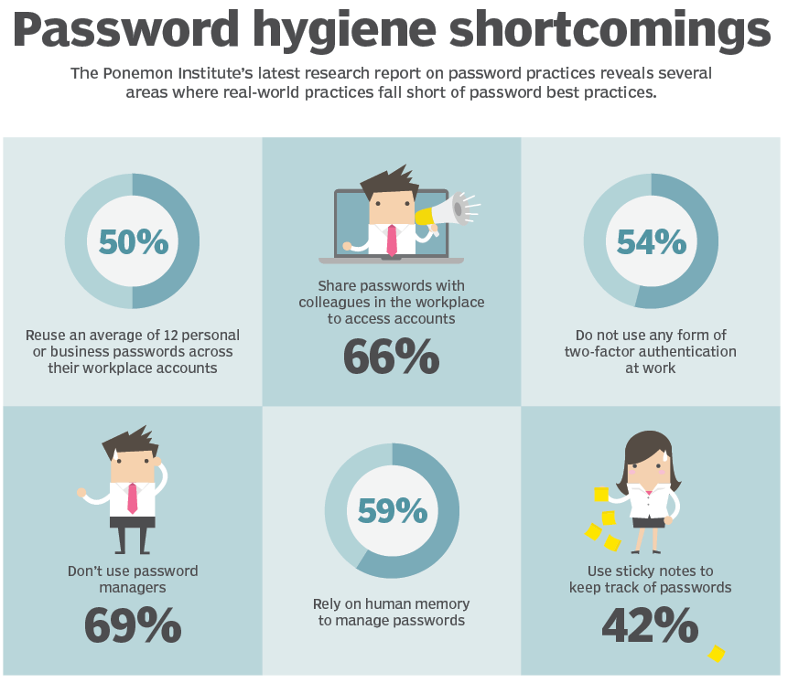
Password Cracking
- A password cracker may also be able to identify encrypted passwords. After retrieving the password from the computer's memory, the program may be able to decrypt it. Or, by using the same algorithm as the system program, the password cracker creates an encrypted version of the password that matches the original.
Password crackers use two primary methods to identify correct passwords: brute-force and dictionary attacks.

Slide 25
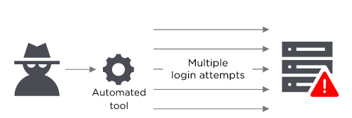
Password Cracking
- If a password is equivalent to using a key to open a door, a brute force attack is using a hammering ram. A hacker can try 2.18 trillion password/username combinations in 22 seconds, and if your password is simple, your account could be in the crosshairs.
- To help prevent brute force attacks use a complex password. The difference between an all-lowercase, all-alphabetic, six-digit password and a mixed case, mixed-character, ten-digit password is enormous. As your password's complexity increases, the chance of a successful brute force attack decreases.
- Require multi-factor authentication. If multi-factor authentication (MFA) is enabled on your account, a potential hacker can only send a request to your second factor for access to your account. Hackers likely won't have access to your mobile device or thumbprint, which means they'll be locked out of your account.

Slide 26
Password Cracking
- Dictionary Attack
A type of brute force attack, dictionary attacks rely on our habit of picking "basic" words as our password, the most common of which hackers have collated into "cracking dictionaries." More sophisticated dictionary attacks incorporate words that are personally important to you, like a birthplace, child's name, or pet's name.
To help prevent a dictionary attack:
- Never use a dictionary word as a password. If you've read it in a book, it should never be part of your password. If you must use a password instead of an access management tool, consider using a password management system.
- Lock accounts after too many password failures. It can be frustrating to be locked out of your account when you briefly forget a password, but the alternative is often account insecurity. Give yourself five or fewer tries before your application tells you to cool down.
- Consider investing in a password manager. Password managers automatically generate complex passwords that help prevent dictionary attacks.

Slide 27
Password Cracking
- Dictionary Attack
A dictionary attack was used on January 4th, 2009 by a hacker known only as GMZ to compromise an administrator account and then change the passwords of famous accounts, including President elect Barack Obama, Britney Spears, and others.

Slide 28
Password Cracking
- What does a password cracking attack look like?
The general process a password cracker follows involves these four steps:
1. Steal a password via some wicked means. That password has likely been encrypted before being stored using a hash. Hashes are mathematical functions that change arbitrary-length inputs into an encrypted fixed-length output.
2. Choose a cracking methodology, such as a brute-force or dictionary attack, and select a cracking tool.
3. Prepare the password hashes for the cracking program. This is done by providing an input to the hash function to create a hash that can be authenticated.
4. Run the cracking tool.

Slide 29
Keyloggers and Spywares
Keylogger:
- Keystroke logging, often referred to as keylogging or keyboard capturing, is the action of recording (or logging) the keys struck on a keyboard, typically in a covert manner so that the person using the keyboard is unaware that their actions are being monitored.
- Keyloggers or keystroke loggers are software programs or hardware devices that track the activities (keys pressed) of a keyboard. Keyloggers are a form of spyware where users are unaware their actions are being tracked.
- It has the capability to record every keystroke you make to a log file, usually encrypted. A keylogger recorder can record instant messages, e-mail, and any information you type at any time using your keyboard.
- The log file created by the keylogger can then be sent to a specified receiver. Some keylogger programs will also record any e-mail addresses you use and Web site URLs you visit.

Slide 30
Keyloggers and Spywares
- Keyloggers can be used for a variety of purposes; hackers may use them to maliciously gain access to your private information, while employers might use them to monitor employee activities.
- Some keyloggers can also capture your screen at random intervals; these are known as screen recorders. Keylogger software typically stores your keystrokes in a small file, which is either accessed later or automatically emailed to the person monitoring your actions.
Legitimate programs may have a keylogging function which can be used to call certain program functions using “hotkeys,” or to toggle between keyboard layouts (e.g. Keyboard Ninja). There is a lot of legitimate software which is designed to allow administrators to track what employees do throughout the day, or to allow users to track the activity of third parties on their computers. However, the ethical boundary between justified monitoring and espionage is a fine line.
- Legitimate software is often used deliberately to steal confidential user information such as passwords.

Slide 31
Keyloggers and Spywares
- There are many examples of cyber criminals using keyloggers – most financial cybercrime is committed using keyloggers, since these programs are the most comprehensive and reliable tool for tracking electronic information.
- In early 2005 the London police prevented a serious attempt to steal banking data. After attacking a banking system, the cyber criminals had planned to steal $423 million from Sumitomo Mitsui’s London-based offices. The main component of the Trojan used, which was created by the 32-year-old Yeron Bolondi, was a keylogger that allowed the criminals to track all the keystrokes entered when victims used the bank’s client interface.

Slide 32
Keyloggers and Spywares
Spyware:
Spyware is any software that installs itself on your computer and starts covertly monitoring your online behavior without your knowledge or permission. For example, by violating their privacy or endangering their device's security.
Spyware is a kind of malware that secretly gathers information about a person or organization without their knowledge and that may send such information to another entity without the consumer’s consent, or that asserts control over a computer without the consumer’s knowledge.
Spyware will take the following actions on your computer or mobile device:
1. Infiltrate — via an app install package, malicious website, or file attachment.
2. Monitor and capture data — via keystrokes, screen captures, and other tracking codes.
3. Send stolen data — to the spyware author, to be used directly or sold to other parties.

Slide 33
Keyloggers and Spywares
- In short, spyware communicates personal, confidential information about you to an attacker.
- Spyware is mostly classified into four types. These four categories are not mutually exclusive and they have similar tactics in attacking networks and devices. The main goal is to install, hack into the network, avoid being detected, and safely remove themselves from the network.
1. Trojan spyware enters devices via Trojan malware, which delivers the spyware program.
2. Adware may monitor you to sell data to advertisers or serve deceptive malicious ads.
3. Tracking cookie files can be implanted by a website to follow you across the internet.
4. System monitors track any activity on a computer, capturing sensitive data such as keystrokes, sites visited, emails, and more. Keyloggers typically fall into this group.

Slide 34
Keyloggers and Spywares
- Each type gathers data for the author or a third-party, all to be used to the attacker’s benefit. The lesser of these harmful types will simply monitor and send your data off to the attacker — like tracking cookies. System monitors and adware are far worse, as they can gather data and may also make modifications to your system that expose you to other threats.
- Spyware is mostly used for the purposes of tracking and storing Internet users’ movements on the Web and serving up pop-up ads to Internet users.
- Whenever spyware is used for malicious purposes, its presence is typically hidden from the user and can be difficult to detect.
- This behavior may be present in malware (it is any software intentionally designed to cause damage to a computer, server, client, or computer network) as well as in legitimate software. Websites may engage in spyware behaviors like web tracking. Hardware devices may also be affected.

Slide 35
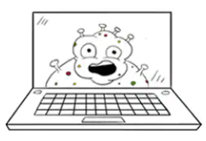
Virus & Worms
Virus:
- A computer virus is a type of computer program that, when executed, replicates itself by modifying other computer programs and inserting its own code. If this replication succeeds, the affected areas are then said to be "infected" with a computer virus, a metaphor derived from biological viruses.
- Computer viruses generally require a host program. The virus writes its own code into the host program. When the program runs, the written virus program is executed first, causing infection and damage.
- Virus writers use social engineering deceptions and exploit detailed knowledge of security vulnerabilities to initially infect systems and to spread the virus.
- The vast majority of viruses target systems running Microsoft Windows, employing a variety of mechanisms to infect new hosts, and often using complex anti-detection/stealth strategies to evade antivirus software.

Slide 36
Virus & Worms
- The signs of a computer virus:
A computer virus attack can produce a variety of symptoms. Here are some of them:
1. Frequent pop-up windows: Pop-ups might encourage you to visit unusual sites. Or they might prod you to download antivirus or other software programs.
2. Changes to your homepage: Your usual homepage may change to another website, for instance. Plus, you may be unable to reset it.
3. Mass emails being sent from your email account: A criminal may take control of your account or send emails in your name from another infected computer.
4. Frequent crashes: A virus can inflict major damage on your hard drive. This may cause your device to freeze or crash. It may also prevent your device from coming back on.

Slide 37
Virus & Worms
5. Unusually slow computer performance: A sudden change of processing speed could signal that your computer has a virus.
6. Unknown programs that start up when you turn on your computer: You may become aware of the unfamiliar program when you start your computer. Or you might notice it by checking your computer’s list of active applications.
7. Unusual activities like password changes: This could prevent you from logging into your computer.
Motives for creating viruses can include seeking profit (e.g., with ransomware), desire to send a political message, personal amusement, to demonstrate that a vulnerability exists in software, for sabotage and denial of service, or simply because they wish to explore cybersecurity issues, artificial life and evolutionary algorithms.

Slide 38
Virus & Worms
- Computer viruses cause billions of dollars' worth of economic damage each year. In response, an industry of antivirus software has cropped up, selling or freely distributing virus protection to users of various operating systems.
- The worst computer virus outbreak in history, Mydoom caused estimated damage of $38 billion in 2004, but its inflation-adjusted cost is actually $52.2 billion. Also known as Novarg, spread by mass emailing. At one point, the Mydoom virus was responsible for 25% of all emails sent.
- The year 2000’s ILOVEYOU virus worked by sending a bogus “love letter” that looked like a harmless text file. Like Mydoom, this attacker sent copies of itself to every email address in the infected machine’s contact list. Shortly after its May 4 release, it had spread to more than 10 million PCs.
- The virus was created by a college student in the Philippines named Onel de Guzman. Lacking funds, he wrote the virus to steal passwords so he could log into online services he wanted to use for free. He reportedly had no idea how far his creation would spread. This virus is also known as Loveletter.

Slide 39
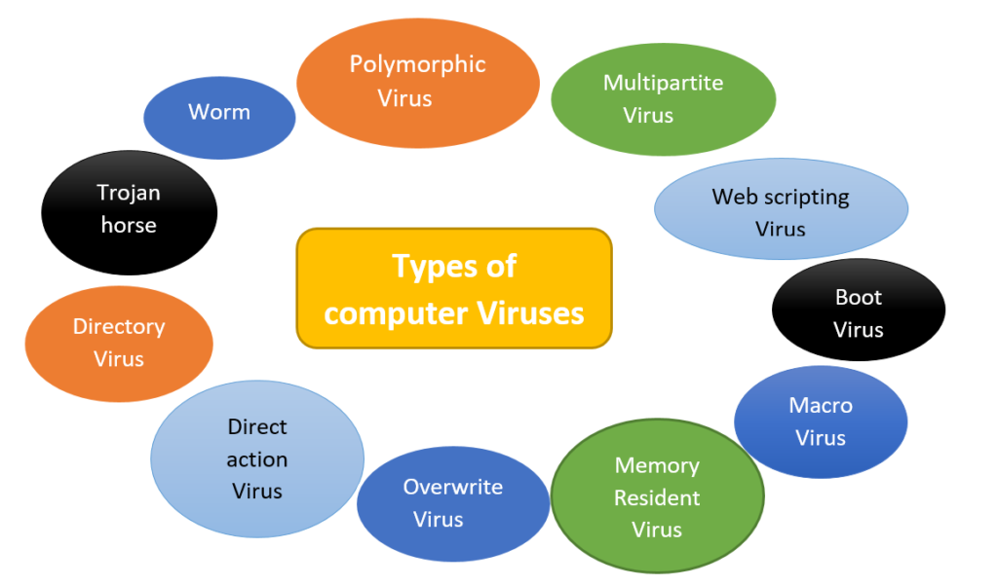
Virus & Worms
-

Slide 40
Virus & Worms
Worm:
- A computer worm is a standalone malware computer program that replicates itself in order to spread to other computers. It often uses a computer network to spread itself, relying on security failures on the target computer to access it.
- It will use this machine as a host to scan and infect other computers. When these new worm-invaded computers are controlled, the worm will continue to scan and infect other computers using these computers as hosts, and this behavior will continue.
- Computer worms use recursive methods to copy themselves without host programs and distribute themselves based on the law of exponential growth, thus controlling and infecting more and more computers in a short time. They spread by exploiting vulnerabilities in operating systems.

Slide 41
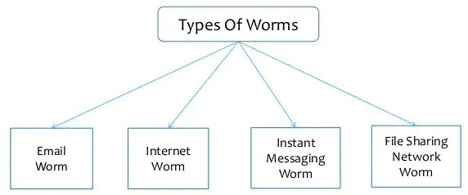
Virus & Worms
Worm:
Worms almost always cause at least some harm to the network, even if only by consuming bandwidth, whereas viruses almost always corrupt or modify files on a targeted computer. Many worms are designed only to spread, and do not attempt to change the systems they pass through.

Slide 42
Virus & Worms
- The actual term "worm" was first used in John Brunner's 1975 novel, The Shockwave Rider. The first ever computer worm was devised to be an anti-virus software. Named Reaper, it was created by Ray Tomlinson to replicate itself across the ARPANET and delete the experimental Creeper program. On November 2, 1988, Robert Tappan Morris, a Cornell University computer science graduate student, unleashed what became known as the Morris worm, disrupting many computers then on the Internet, guessed at the time to be one tenth of all those connected.
Examples:
1. The Morris Worm:
It was launched in 1988 by Robert Morris, an American student who wanted to discover how big the internet really was. To do this, he launched a few dozen lines of code, but he didn’t know that the code was riddled with bugs that would cause a variety of problems on affected hosts. The result was thousands of overloaded computers running on UNIX and a financial damage ranging between $10 million and $100 million.

Slide 43
Virus & Worms
2. The Storm Worm:
It is an email worm launched in 2007. Victims would receive emails with a fake news report about an unprecedented storm wave that had already killed hundreds of people across Europe. More than 1.2 billion of these emails were sent over the course of ten years in order to create a botnet that would target popular websites. Experts believe that there are still at least a million infected computers whose owners don’t know that they are part of a botnet.

Slide 44
Trojan Horses and Backdoors
Trojan Horse:
Trojan horse (or simply trojan) is any malware that misleads users of its true intent. The term is derived from the Ancient Greek story of the deceptive Trojan Horse that led to the fall of the city of Troy.
Trojans are generally spread by some form of social engineering, for example where a user is duped into executing an email attachment disguised to appear not suspicious, (e.g., a routine form to be filled in), or by clicking on some fake advertisement on social media or anywhere else.
Ransomware attacks are often carried out using a trojan. Unlike computer viruses and worms, trojans generally do not attempt to inject themselves into other files or otherwise propagate themselves.

Slide 45
Trojan Horses and Backdoors
- A Trojan horse is a type of malware that downloads onto a computer disguised as a legitimate program. A Trojan horse is so-called due to its delivery method, which typically sees an attacker use social engineering to hide malicious code within legitimate software.
- It gets hidden as an attachment in an email or a free-to-download file, then transfers onto the user’s device. Once downloaded, the malicious code will execute the task the attacker designed it for, such as gain backdoor access to corporate systems, spy on users’ online activity, or steal sensitive data.
- A Trojan virus spreads through legitimate-looking emails and files attached to emails, which are spammed to reach the inboxes of as many people as possible. When the email is opened and the malicious attachment is downloaded, the Trojan server will install and automatically run every time the infected device is turned on.

Slide 46
Trojan Horses and Backdoors
- Devices can also be infected by a Trojan through social engineering tactics, which cyber criminals use to bully users into downloading a malicious application. The malicious file could be hidden in banner advertisements, pop-up advertisements, or links on websites.
- For example, a user might receive an email from someone they know, which includes an attachment that also looks legitimate. However, the attachment contains malicious code that executes and installs the Trojan on their device. The user often will not know anything problematic has occurred, as their computer may continue to work normally with no signs of it having been infected.

Slide 47
Trojan Horses and Backdoors
Backdoors:
- A backdoor is a typically covert method of bypassing normal authentication or encryption in a computer. It is most often used for securing remote access to a computer.
- From there it may be used to gain access to privileged information like passwords, corrupt or delete data on hard drives, or transfer information within networks.
- A backdoor is a means of access to a computer program that bypasses security mechanisms.
- The backdoor attack is a type of malware that is used to get unauthorized access to a website by the cybercriminals. The cybercriminals spread the malware in the system through unsecured points of entry.

Slide 48
Trojan Horses and Backdoors
- The malware is entered in the system through the backdoor and it makes it ways to the company’s sensitive data including customer personally identifiable information.
- A backdoor is a malware type that negates normal authentication procedures to access a system. As a result, remote access is granted to resources within an application, such as databases and file servers, giving perpetrators the ability to remotely issue system commands and update malware.
- Backdoor installation is achieved by taking advantage of vulnerable components in a web application. Once installed, detection is difficult as files tend to be highly complicated.

Slide 49
Trojan Horses and Backdoors
- Example of a Backdoor Virus
There are many different types of backdoors which target different vulnerability spots in a system of application. A well-known backdoor example is called FinSpy.
When installed on a system, it enables the attacker to download and execute files remotely on the system the moment it connects to the internet, irrespective of the system's physical location. It compromises overall system security.
Firewall settings and other security configurations are changed. It is a difficult intrusion to detect with the attacker using random relatable file names. The malicious code runs on the system's startup routine.

Slide 50
Steganography
- Steganography is the practice of hiding a secret message within an ordinary, non-secret, file or message in order to avoid detection; the secret data is then extracted at its destination. The use of steganography can be combined with encryption as an extra step for hiding or protecting data.
- The word steganography is derived from the Greek words steganos (meaning hidden or covered) and the Greek root graph (meaning to write).
- These days, many examples of steganography involve embedding a secret piece of text inside of a picture. Or hiding a secret message or script inside of a Word or Excel document.
- The purpose of steganography is to conceal and deceive. It can be used to conceal almost any type of digital content, including text, image, video or audio content; the data to be hidden can be hidden inside almost any other type of digital content.

Slide 51
Steganography
- It is a form of covert communication and can involve the use of any medium to hide messages. It’s not a form of cryptography, because it doesn’t involve scrambling data or using a key. Instead, it is a form of data hiding and can be executed in clever ways. Where cryptography is a science that largely enables privacy, steganography is a practice that enables secrecy.
- Steganography is an ancient practice, being practiced in various forms for thousands of years to keep communications private. For Example:
• The first use of steganography can be traced back to 440 BC when ancient Greece, people wrote messages on wood and covered it with wax, that acted as a covering medium
• Romans used various forms of Invisible Inks, to decipher those hidden messages light or heat were used

Slide 52
Steganography
• During World War II the Germans introduced microdots, which were complete documents, pictures, and plans reduced in size to the size of a dot and were attached to normal paperwork
• Null Ciphers were also used to hide unencrypted secret messages in an innocent looking normal message
- Now, we have a lot of modern steganographic techniques and tools to make sure that our data remains secret. There are a number of apps that can be used for steganography, including Steghide, Xiao, Stegais and Concealment.
- Steganography Techniques
Depending on the nature of the cover object(actual object in which secret data is embedded), steganography can be divided into five types:
Text Steganography
Image Steganography
Video Steganography
Audio Steganography
Network Steganography

Slide 53
DoS and DDoS Attacks
Denial of Service (DoS) Attack:
- Denial-of-service attack (DoS attack) is a cyber-attack in which the perpetrator seeks to make a machine or network resource unavailable to its intended users by temporarily or indefinitely disrupting services of a host, connected to the Internet.
- Denial of service is typically accomplished by flooding the targeted machine or resource with excessive requests in an attempt to overload systems and prevent some or all legitimate requests from being fulfilled.
- It floods a server with traffic, making a website or resource unavailable. The attack is such that the victim’s computer shuts down. While attacking, the focus is to burden the victim’s server affecting its capabilities forcing the computer to shut down.
- DoS attack is an online attack. When the attack is made on a website, it is made completely unavailable for its users. The target web site’s server is bombarded with huge traffic from hackers’ system to shut its services.

Slide 54
DoS and DDoS Attacks
- Panix, the third-oldest ISP in the world, was the target of what is thought to be the first DoS attack. On September 6, 1996, Panix was subject to a SYN flood attack which brought down its services for several days while hardware vendors, notably Cisco, figured out a proper defense.
- Another early demonstration of DoS attack was made by Khan C. Smith in 1997 during a DEF CON event, disrupting Internet access to the Las Vegas Strip for over an hour. The release of sample code during the event led to the online attack of Sprint, EarthLink, E-Trade, and other major corporations in the year to follow.
- Criminal perpetrators of DoS attacks often target sites or services hosted on high-profile web servers such as banks or credit card payment gateways. Revenge, blackmail and activism can motivate these attacks.
- Denial-of-service attacks are characterized by an explicit attempt by attackers to prevent legitimate use of a service. There are two general forms of DoS attacks: those that crash services and those that flood services. The most serious attacks are distributed.

Slide 55
DoS and DDoS Attacks
Distributed denial-of-service attack (DDoS):
- In a distributed denial-of-service attack (DDoS attack), the incoming traffic flooding the victim originates from many different sources. This effectively makes it impossible to stop the attack simply by blocking a single source.
- A DDoS attack is a distributed denial-of-service attack wherein the victim’s computer is bombarded with traffic from multiple systems across different locations. The focus is to burden the victim’s server such that it stops working as expected. If it is a network, the server becomes inaccessible to all its users.
- It occurs when multiple systems flood the bandwidth or resources of a targeted system, usually one or more web servers. A DDoS attack uses more than one unique IP address or machines, often from thousands of hosts infected with malware.
- A distributed denial of service attack typically involves more than around 3–5 nodes on different networks.

Slide 56
DoS and DDoS Attacks
- Unlike other kinds of cyber-attacks, DDoS assaults don’t attempt to breach your security perimeter. Rather, a DDoS attack aims to make your website and servers unavailable to legitimate users.
- A successful distributed denial of service attack is a highly noticeable event impacting an entire online user base. This makes it a popular weapon of choice for hacktivists, cyber vandals, extortionists and anyone else looking to make a point or champion a cause.
- Some common examples of DDoS attacks are UDP flooding, SYN flooding and DNS amplification.
- On March 5, 2018, an unnamed customer of the US-based service provider Arbor Networks fell victim to the largest DDoS to that date, reaching a peak of about 1.7 terabits per second.

Slide 57
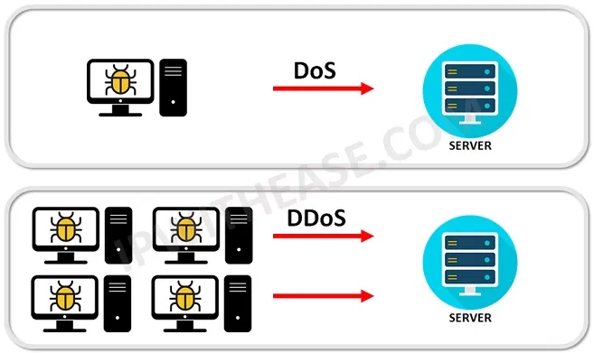
DoS and DDoS Attacks
- The previous record had been set a few days earlier, on March 1, 2018, when GitHub was hit by an attack of 1.35 terabits per second.
- In February 2020, Amazon Web Services experienced an attack with a peak volume of 2.3 terabits per second.
- In September 2017, Google Cloud experienced an attack with a peak volume of 2.54 terabits per second.

Slide 58
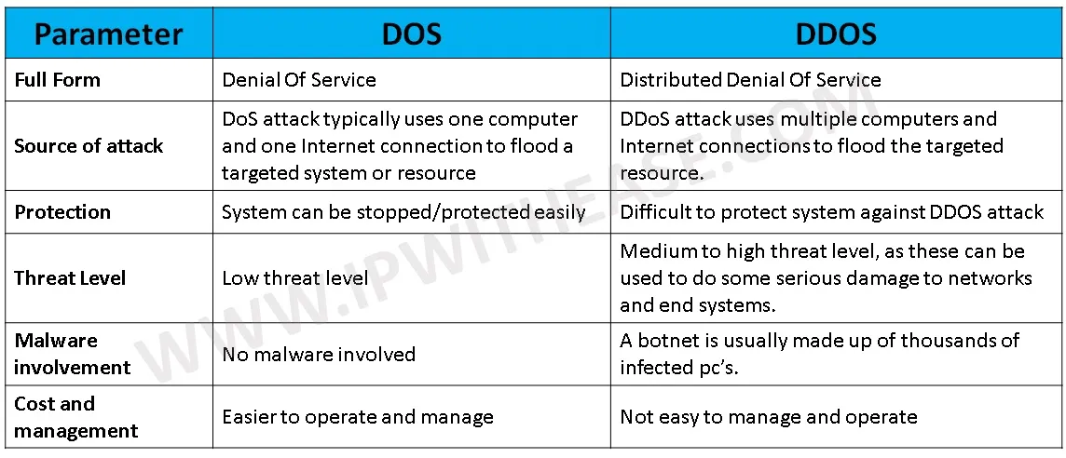
DoS and DDoS Attacks
-

Slide 59
SQL Injection
- SQL injection is a code injection technique used to attack data-driven applications, in which malicious SQL statements are inserted into an entry field for execution (e.g. to dump the database contents to the attacker).
- SQL injection is a web security vulnerability that allows an attacker to interfere with the queries that an application makes to its database. It generally allows an attacker to view data that they are not normally able to retrieve.
- This might include data belonging to other users, or any other data that the application itself is able to access. In many cases, an attacker can modify or delete this data, causing persistent changes to the application's content or behavior.
- In some situations, an attacker can escalate an SQL injection attack to compromise the underlying server or other back-end infrastructure, or perform a denial-of-service attack.

Slide 60
SQL Injection
- SQL injection attacks allow attackers to spoof identity, tamper with existing data, cause repudiation issues such as voiding transactions or changing balances, allow the complete disclosure of all data on the system, destroy the data or make it otherwise unavailable, and become administrators of the database server.
- SQL injection (SQLI) was considered one of the top 10 web application vulnerabilities of 2007 and 2010 by the Open Web Application Security Project. There are four main sub-classes of SQL injection:
1. Classic SQLI
2. Blind or Inference SQL injection
3. Database management system-specific SQLI
4. Compounded SQLI
• SQL injection + insufficient authentication[7]
• SQL injection + DDoS attacks[8]
• SQL injection + DNS hijacking[9]
• injection + XSS[10]
The Storm Worm is one representation of Compounded SQLI.

Slide 61
SQL Injection
- On November 1, 2005, a teenaged hacker used SQL injection to break into the site of a Taiwanese information security magazine from the Tech Target group and steal customers' information.
- On January 13, 2006, Russian computer criminals broke into a Rhode Island government website and allegedly stole credit card data from individuals who have done business online with state agencies.
- On March 29, 2006, a hacker discovered an SQL injection flaw in an official Indian government's tourism site.
- On August 17, 2009, the United States Department of Justice charged an American citizen, Albert Gonzalez, and two unnamed Russians with the theft of 130 million credit card numbers using an SQL injection attack. It was the biggest case of identity theft in American history.

Slide 62


